Slide 1
Data 608 - Final Project
Vijaya Cherukuri

Slide 2
Admission & Readmission Project
We are trying to find out the reason for patients to be admitted to hospitals.
Eg : Cardiology, Orthopedic, Neurology, General surgery etc.
Health Insurance companies and Hospitals are penalized when patients are discharged and readmitted within 30 days.
Readmissions are associated with negative patient and financial outcomes. A readmission can be defined in multiple ways, including:
Patients who are readmitted to the same hospital, or another applicable acute care hospital with same reason.
Patients who are readmitted to the same hospital, or another applicable acute care hospital with different reason.
Some companies use multiple techniques like Utilization Management to reduce the risks.

Slide 3
About Dataset
Diabetes dataset from UCI.
http://archive.ics.uci.edu/ml/datasets/diabetes+130-us+hospitals+for+years+1999-2008
The UCI Machine Learning Repository: Diabetes 130-US Hospitals for years 1999-2008 of clinical care at 130 US hospitals and integrated delivery networks. It includes over 50 features representing patient and hospital outcomes.
Data Set contains
100000 instances of data, with 55 attributes.
Attributes such as patient’s race, gender, age, time in hospital, number of lab tests performed, number of in-patient, outpatient, and emergency visits for prior year, etc.

Slide 4
Project Questions :
Find out Patient demographics
Gender
Race
Age
Race-Gender Distribution
Age-Race Distribution
Race-Age Distribution
Medication history – To find out for which reasons patients are admitting to hospitals.
Readmissions occuring in
<30 days
>30 days
No readmissions

Slide 5
Data Wrangling :
In the dataset there are some values with “?”. We are replacing these values as Unknown.
These changes are made to find out the demographics
-> Race-Age
-> Race-Gender
-> Age-Gender
I filtered data which having “?” for readmission as these values does not give any insight and will be misleading.
These changes are made for
-> Medical Speciality
-> Readmission

Slide 6
Project Details :
We created an app using Plotly Dash to create interactive visualizations of our dataset.
The visualizations will include various forms including:
Patient demographics (age, sex, race etc.)
Medication history and how medications impact a patient being readmitted to the hospital

Slide 7
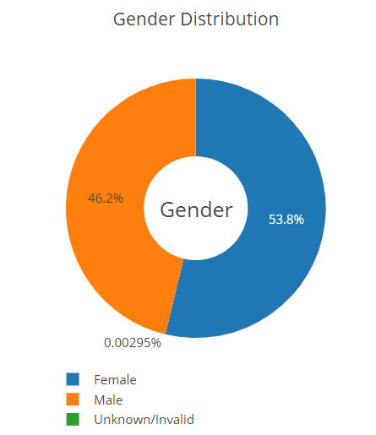
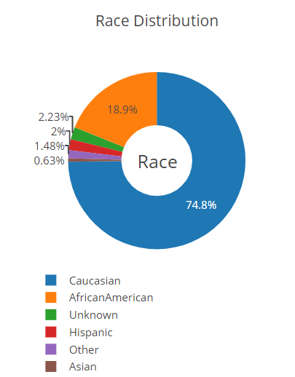
Visualizations

Slide 8
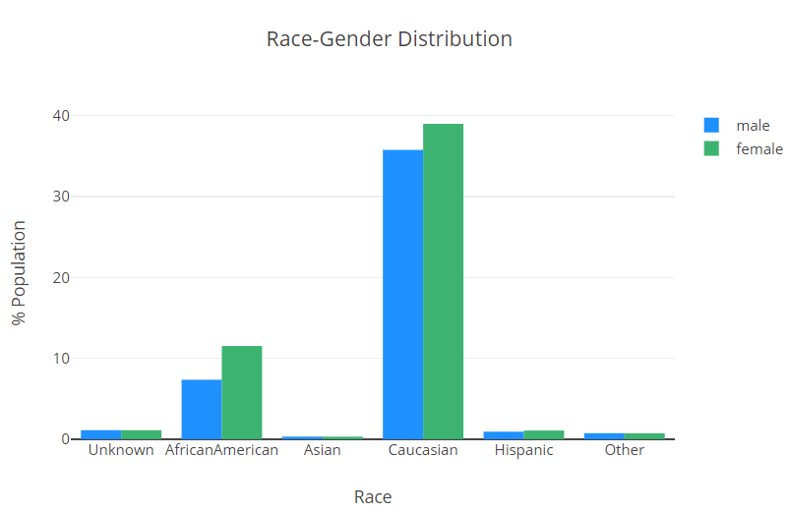
Visualizations

Slide 9
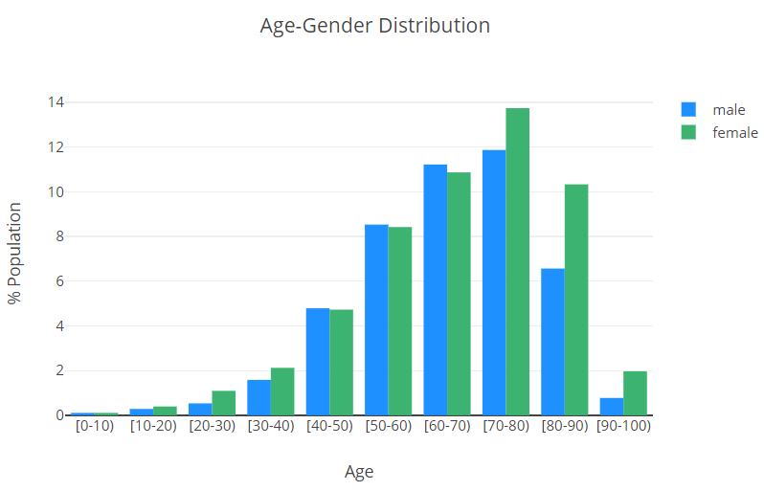
Visualizations

Slide 10
Visualizations

Slide 11
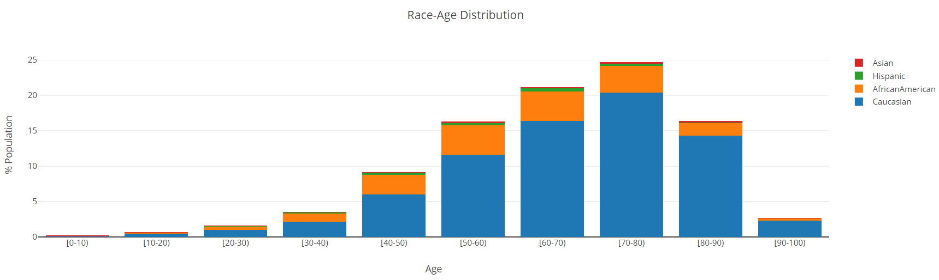
Visualizations

Slide 12
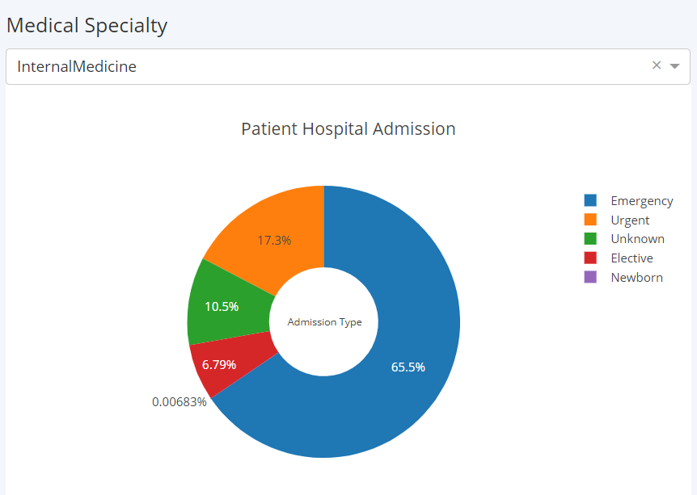

Slide 13
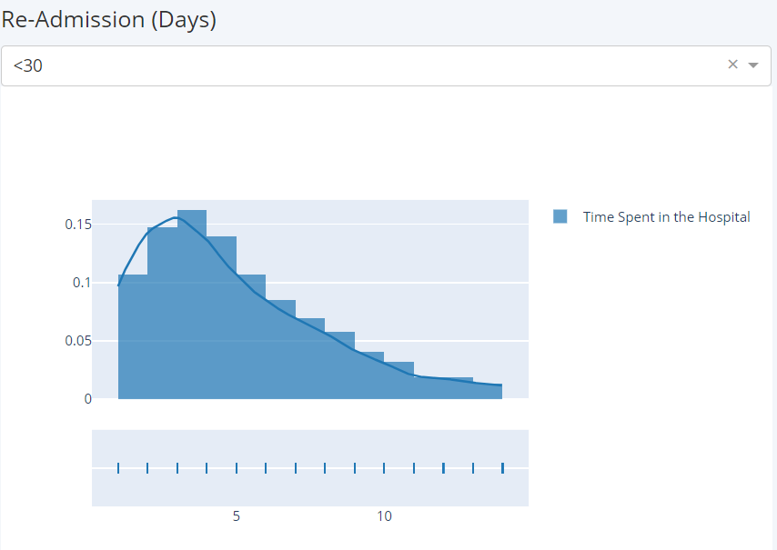

Slide 14
Github and Herokuapp links
Github link: https://github.com/vijay564/DATA608/blob/master/Finalpro/app.py
Heroku App link :
https://finalpro-data608.herokuapp.com/

Slide 15
Future Scope
The data is collected only from 130 hospitals. If the data is collected from more hospitals with each specialized, emergency care and general hospitals we can get more details.
Dataset has some “?” values. With these values it is hard to come to a conclusion on Patient Admission, Discharge and Readmission reasons.
There are no reasons for readmissions. We done know whether they readmitted for the same reason or for a different reason.
Eg : If we have diagnosis code and reasons for admitting then we can have more insight of what was going on.
Similarly chronic conditions and treatment data is not provided in the dataset which adds more value during machine learning.

Slide 16
Thank you

